Slide 1
The Past Simple Tense. Regular verbs.

Slide 2

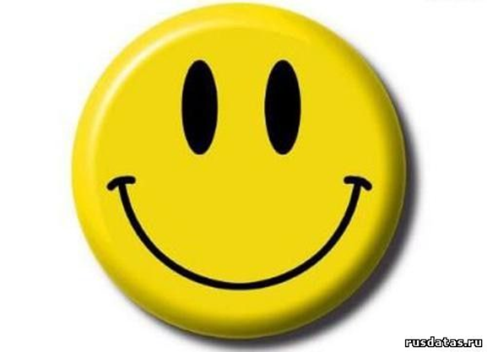
What is your mood today?

Slide 3
The Past Simple expresses:
(choose the right variants)
the action is going on at the present time
a regular action in the present
the action is happening now
the action happened in the past
the action is going on at the moment of speaking

Slide 4
Correct the mistake.
I play with my dog yesterday.

Slide 5
The rules of reading:

Slide 6
Put the verbs into the right column:
Passed, closed, opened, added, started, talked, lived, painted, watched, played, walked, climbed, visited, studied, served, listened, clapped, shouted.
/d/ | /t/ | /id/

Slide 7
The Past Simple Tense.
“+” S+ V –ed / V-2
“-“ S+ did not / didn’t + V -1
“?” Did + S + V-1 ?
Yes, S + did / No, S + didn’t

Slide 8
Make up positive, negative and interrogative sentenses:
1. TV, watched, we, yesterday.
2. Sunday, Kate, last, and, at, Ann, party, danced, the.
3. ago, three, children, days, skated .

Slide 9
Correct the mistakes:

Slide 10
If you’re happy!
If you're happy and you know it, clap your hands!
If you're happy and you know it, clap your hands!
If you're happy and you know it,
Then your face will surely show it.
If you're happy and you know it, clap your hands!
If you're happy and you know it, stamp your feet!
If you're happy and you know it, stamp your feet!
If you're happy and you know it,
Then your face will surely show it.
If you're happy and you know it, stamp your feet!
If you're happy and you know it, shout Hooray!
If you're happy and you know it, shout Hooray!
If you're happy and you know it,
Then your face will surely show it.
If you're happy and you know it, shout Hooray!
If you're happy and you know it, do all three!
If you're happy and you know it, do all three!
If you're happy and you know it,
Then your face will surely show it.
If you're happy and you know it, do all three!

Slide 11
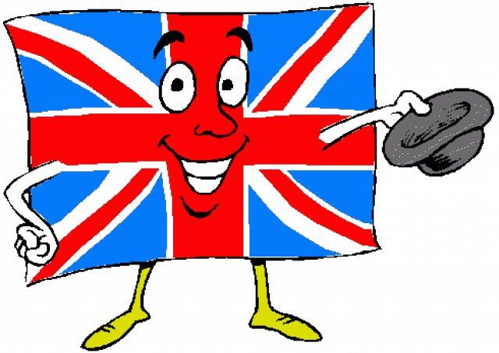
The lesson is over:
Thank you very much for your attention!
Good bye!

